Slide 1

Smart Grocery Store Assistant
An AI Conversational Action for retail customer support, built on IBM watsonx Assistant
Guided shopping · Payment assistance · Returns handling
Name: Chandni Jaiswal
Reg No.: 12506984

Slide 2



Project Overview
Grocery is a rule-based conversational action built with IBM watsonx Assistant Lite. It listens for a customer query and routes the conversation through decision-tree logic to answer product, payment, and return questions instantly — no human agent required.
Guide to Products
Payment Support
Returns Handling
Routes shoppers to the right aisle by category — produce, dairy, meat & seafood, pantry.
Explains UPI, card, and cash options so checkout never causes confusion.
Shares return-window policy instantly, without a trip to the service desk.
Grocery Store Chatbot · IBM watsonx Assistant
2

Slide 3



How the Conversation Flows
Every session starts the same way, then branches by intent using condition logic in the Action editor.
Customer: "I have a Query"
Step 1 · "What do you want to ask?"
Buying Product
Payment
Return
Product category menu
(4 categories)
Payment method menu
(UPI / Card / Cash)
Return window
shared instantly
Grocery Store Chatbot · IBM watsonx Assistant
3

Slide 4




Guiding Customers to Products
When intent = "Buying Product," the bot asks for a category, then replies with aisle guidance conditioned on the exact product chosen.
Produce
Dairy & Eggs
Meat & Seafood
Pantry & Dry Goods
Fruits → “Fresh Fruits on the way in row 1.”
Vegetables → “Fresh Fruits on the way in row 2.”
“Dairy product and milk product — you can find it in the freezer area.”
Meat → “Yay! Fresh meat is freezer area.”
Seafood → “Oops! This product is currently unavailable.”
“Exciting offer is going on for this category product.”
Grocery Store Chatbot · IBM watsonx Assistant
4

Slide 5



Frictionless Checkout Guidance
Step 11 asks "Which method you want to opt for?" — the response is conditioned on the exact answer.
UPI
Card
Cash
“Scan the QR and enjoy Shopping.”
“Machine is present in the counter. Tap and Shop.”
“Go to the payment counter for cash payment.”
Grocery Store Chatbot · IBM watsonx Assistant
5
5

Slide 6


Returns, Answered Instantly
When intent = "Return," step 15 replies with the store’s return-window policy and closes the action.
No service-desk queue for a simple policy question
Consistent, always-on messaging — same answer every time
12–2 PM
Marks the action complete, ending the conversation cleanly
Return window
(afternoon)
Grocery Store Chatbot · IBM watsonx Assistant
6

Slide 7
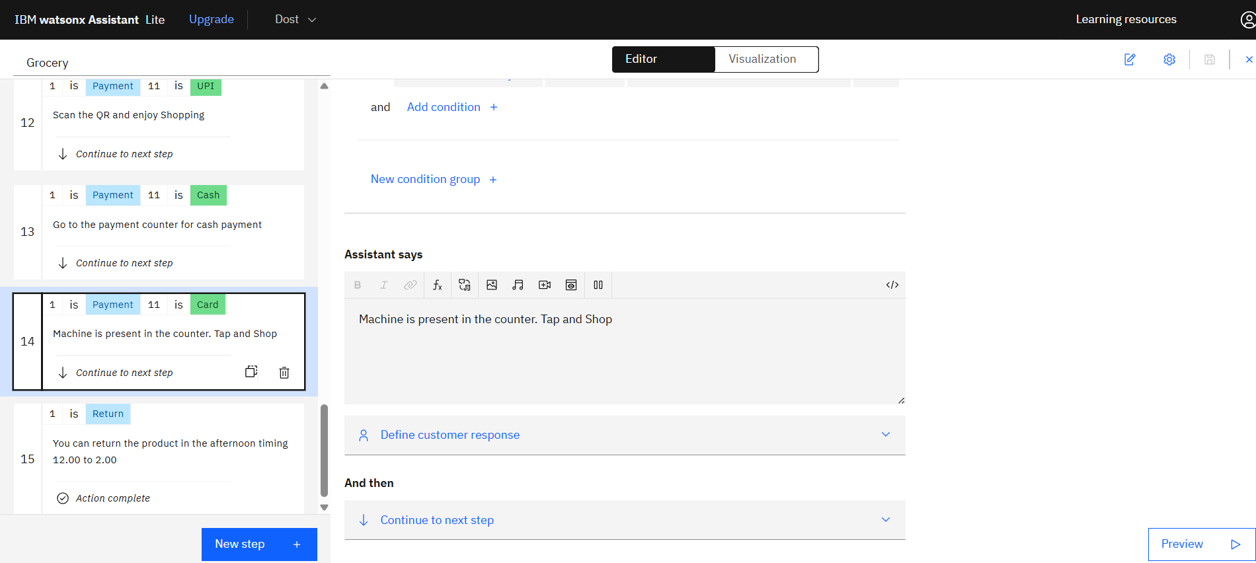
Built with the watsonx Assistant Action Editor
Each step pairs a condition (variable = value) with an assistant response. This example fires when Payment = Card, telling the shopper to tap at the counter machine.
Grocery Store Chatbot · IBM watsonx Assistant
7

Slide 8



Why a No-Code Action Bot Works Here
24/7 Availability
Structured Decision Tree
Answers product, payment, and return questions any time the store is open — or closed.
Nested conditions (intent → category → item) keep responses precise and relevant.
Fast to Build
Easy to Extend
Assembled visually in watsonx Assistant Lite — no custom backend code required.
New categories, payment types, or policies are added as new conditioned steps.
Grocery Store Chatbot · IBM watsonx Assistant
8

Slide 9
What's Next
Connect live inventory so aisle & stock answers update in real time
Add multi-language support for a wider customer base
Hand off to a human agent for complex or unresolved queries
Log conversations to spot the most common shopper questions
Thank you

